Slide 1
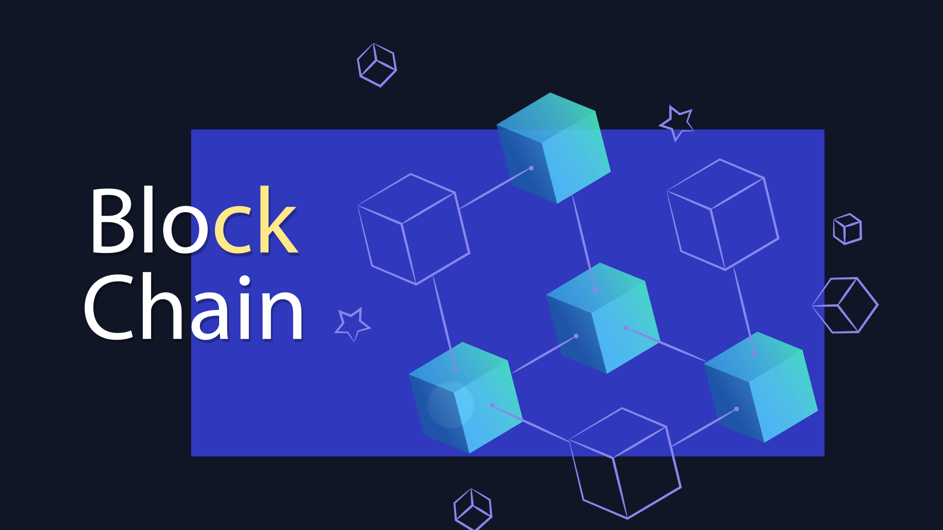
z

Slide 2
What is Block chain ?
Blockchain is a system of recording information in a way that makes it difficult or impossible to change, hack, or cheat the system. A blockchain is essentially a digital ledger of transactions that is duplicated and distributed across the entire network of computer systems on the blockchain
Each node has the entire database, whenever new
Data is to be added it is synced with each node.

Slide 3
Trust Frameworks and Consensus Mechanisms
Consensus, as a concept, is fundamental to any system where more than one entity is participating.
As a public blockchain aims to include any participant that runs a node, there is a need to quickly reach agreement on whether to accept a new block as part of the chain when it is mined. Without the ability to reach this agreement, the blockchain can not create new blocks. A consensus mechanism is a set of rules that allows multiple machines that are connected together to work together while tolerating some machines providing incorrect data or failing completely. A blockchain needs a consensus mechanism to ensure there are a set of rules for creating and accepting each newly created block.

Slide 4
Cryptography in block chain: Public Key Cryptography
If I want to send a message to someone on a public network like blockchain I’ll need two related cryptographic keys, a public one I can share with anyone who wants to send me a message, and a private one that I keep with myself. Let's call them public key A and private key A, because they're a matching pair, like a lock and key. Its a little confusing calling both keys because the public key is used a bit like a lock.
Public key A is used to encrypt or perhaps lock messages and private key A is decrypts messages but only if they were encrypted with the matching public key A. The public key is called that because it can be shared openly,

Slide 5
A third party may be able to see I am sending a message, but there is no way to tell what I’m saying. And since recipient used my public key A to encrypt the message, the only corresponding key that can decrypt it is private key A. And since I am the only one in possession of that, recipient can be assured that only I can read the message

Slide 6
Why Do I Need a Public and Private Key on the Blockchain?
When someone sends you cryptocoins over the Blockchain, they are actually sending them to a hashed version of what’s known as the “Public Key”. There is another key which is hidden from them, that is known as the “Private Key.” This Private Key is used to derive the Public Key. You can know your own Private Key, and everyone else on the Blockchain knows their own Private Key, but the Private Key should not be shared with outsiders

Slide 7
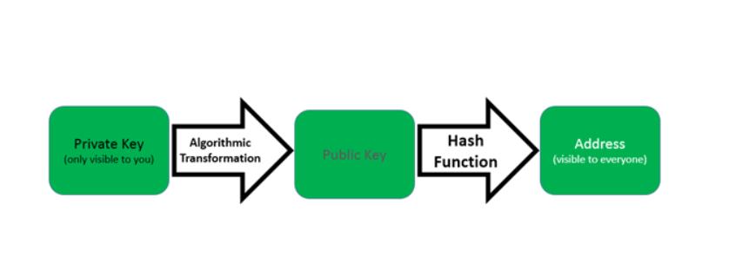
you sign the cryptocurrencies you send to others using a Private Key. If someone were to obtain your private key, they would be able to send your cryptocurrencies to themselves, verifying that transaction with the Private Key
The Private Key is used to mathematically derive the Public Key, which (along with information about the network and a checksum)is then transformed with a hash function to produce the address that other people can see. You receive cryptocurrencies that others send to your address (which is a result of the hash of your public key and some additional information).

Slide 8
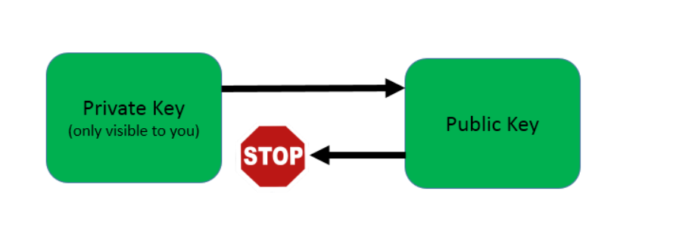
if a Public Key is derived from a Private Key, couldn’t someone create a reverse key generator?
Crypto currencies use a complicated algorithm to solver the issue, called RSA algorithm.
he algorithm makes it very easy to generate Public Keys from Private Keys, but it is very difficult to “reverse” the algorithm to accomplish the opposite.
the process of reversing the process is even more complex — so much so that the world’s most powerful computer would need more than 40000000000000000000000000000000 years (that’s 31 zeroes!) to complete this calculation.

